Slide 1

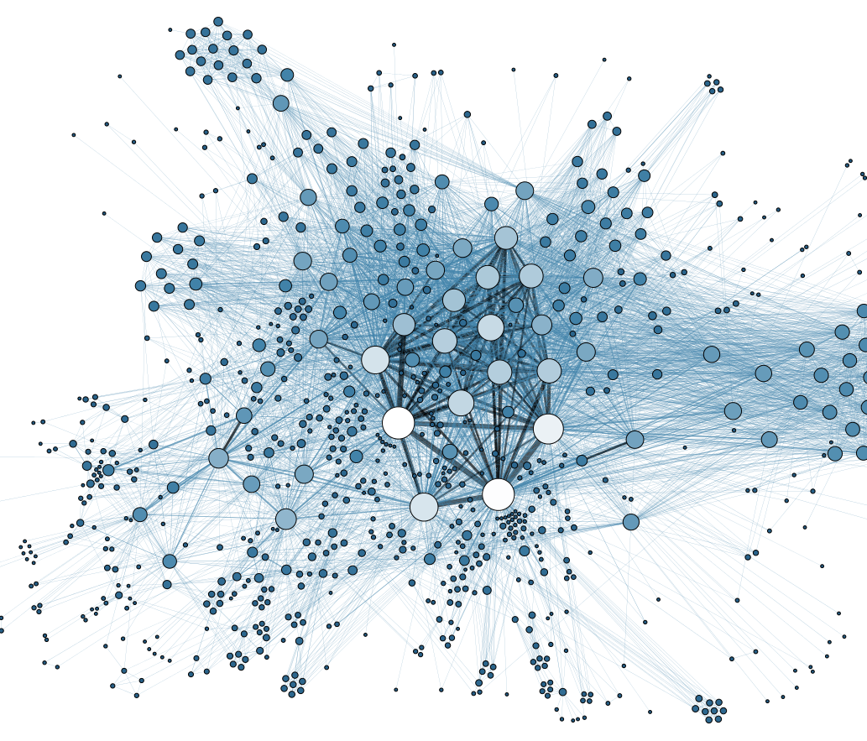

D606 Data Science Capstone
Warren Buenarte
This Photo by Unknown Author is licensed under CC BY-SA
This Photo by Unknown Author is licensed under CC BY
This Photo by Unknown Author is licensed under CC BY-SA-NC

Slide 2
Intro and Background
Warren Buenarte
Western Governors University
MS Data Analytics (Data Science)

Slide 3
Statement of the problem and the hypothesis
The research question for this project is: Can a patient's demographic and health-related attributes (such as age, gender, blood pressure, and heart rate) be used to predict the risk of a heart attack?
This question is justified by the high prevalence and mortality rate of heart disease globally. Early identification of at-risk individuals can enable timely intervention and prevention, potentially saving lives and optimizing healthcare resources.
Context:
Heart disease is a leading cause of death worldwide. Hospitals and clinicians often have access to basic demographic and health indicators for patients. Leveraging these data points with machine learning can help identify patterns and predictors of heart attack risk, supporting clinical decision-making.
Hypothesis:
Null Hypothesis: There is no statistically significant relationship between a patient's health indicators and the likelihood of a heart attack.
Alternative Hypothesis: There is a statistically significant relationship between a patient's health indicators and the likelihood of a heart attack.

Slide 4
Summary of the data analysis process
Imported the data and handled missing values and outliers
Splitted the data in 80% training and 20% test
Performed logistic regression and random forest modeling

Slide 5
Explanation of the limitations of the techniques and tools used
For this project, I used two supervised classification techniques: Logistic Regression and Random Forest. Both are appropriate for predicting a binary outcome (heart attack: yes/no) based on patient features.
Calculations Performed and Outputs
1. Data Preparation:
I handled missing values using mean imputation for numeric columns and the most frequent value for categorical columns. Outliers were capped at the 1st and 99th percentiles. All numeric features were normalized using StandardScaler. The target variable Result was converted to binary (0 for negative, 1 for positive).
2. Correlation Analysis: I generated a feature correlation matrix using a heatmap to visualize relationships between variables. This helped identify which features were most strongly associated with heart attack outcomes. For example, Troponin and CK-MB showed moderate positive correlations with the target.
3. Model Training and Evaluation: The data was split into training and test sets (80/20 split). Logistic Regression and Random Forest models were trained on the training set. For both models, I calculated: Confusion Matrix (e.g., for Logistic Regression: [[70, 31], [23, 140]]) Accuracy (Logistic Regression: 0.80, Random Forest: 0.98) Precision (Logistic Regression: 0.82, Random Forest: 0.98 Recall (Logistic Regression: 0.86, Random Forest: 0.99) AUC-ROC (Logistic Regression: 0.89, Random Forest: 0.99) I also plotted ROC curves to visually compare model performance. Justification for Analysis Techniques Logistic Regression: Why chosen: It is a simple, interpretable model that provides probability estimates and is widely used for binary classification. Advantage: Easy to interpret and understand feature importance. Disadvantage: Assumes a linear relationship between features and the log-odds of the outcome, which may not capture complex patterns. Random Forest: Why chosen: It is a robust ensemble method that can model complex, nonlinear relationships and is less sensitive to outliers. Advantage: High accuracy and can capture nonlinear interactions between features. Disadvantage: Less interpretable than logistic regression and can require more computational resources.

Slide 6
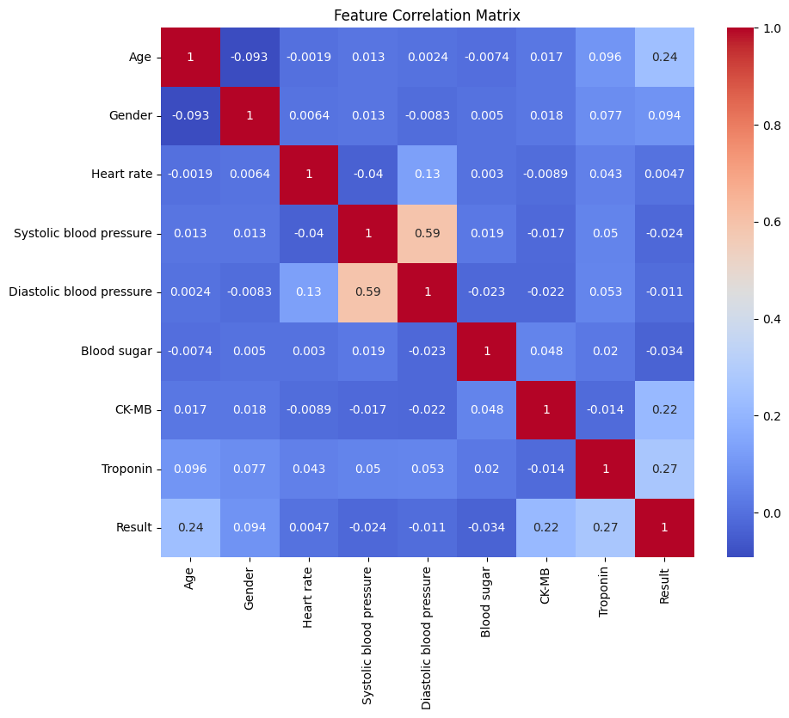
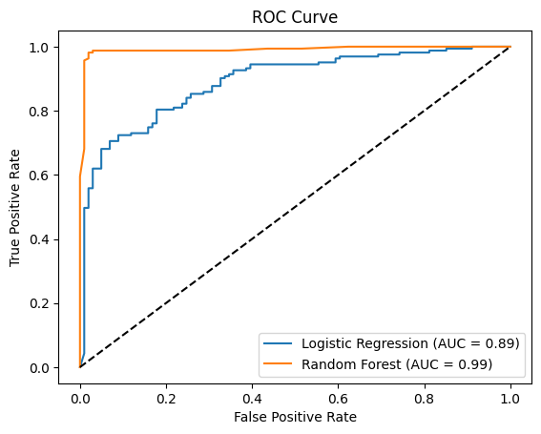
Outline of the findings
Logistic Regression Evaluation:
Confusion Matrix:
[[ 70 31]
[ 23 140]]
Accuracy: 0.7954545454545454
Precision: 0.8187134502923976
Recall: 0.8588957055214724
AUC-ROC: 0.8903298305290651
Random Forest Evaluation:
Confusion Matrix:
[[ 97 4]
[ 2 161]]
Accuracy: 0.9772727272727273
Precision: 0.9757575757575757
Recall: 0.9877300613496932
AUC-ROC: 0.9903116078479012
Age Gender Heart rate Systolic blood pressure Diastolic blood pressure \
0 64 1 66 160 83
1 21 1 94 98 46
2 55 1 64 160 77
3 64 1 70 120 55
4 55 1 64 112 65
Blood sugar CK-MB Troponin Result
0 160.0 1.80 0.012 negative
1 296.0 6.75 1.060 positive
2 270.0 1.99 0.003 negative
3 270.0 13.87 0.122 positive
4 300.0 1.08 0.003 negative
(1319, 9)
Index(['Age', 'Gender', 'Heart rate', 'Systolic blood pressure',
'Diastolic blood pressure', 'Blood sugar', 'CK-MB', 'Troponin',
'Result'],
dtype='object')

Slide 7
Summary of proposed actions
Both models performed well, but the random forest classifier achieved higher accuracy (0.98) and AUC-ROC (0.99), indicating excellent predictive performance. Logistic regression also performed strongly, with an accuracy of 0.80 and AUC-ROC of 0.89. This suggests that demographic and health-related attributes can be used to predict heart attack risk with high reliability.
The dataset is from a single hospital and may not generalize to other populations or healthcare settings. Additionally, the random forest model, while accurate, is less interpretable, which may limit its clinical adoption.
Based on these results, clinicians could use similar models as decision-support tools to identify high-risk patients for early intervention. However, further validation on diverse datasets is recommended before clinical deployment.
External Validation: Test the model on data from other hospitals or regions to assess generalizability.
Feature Expansion: Incorporate additional clinical variables (cholesterol, family history) or use advanced models (XGBoost, neural networks) to potentially improve performance.

Slide 8
Expected benefits of the study
Improved Patient Outcomes:
By accurately predicting the likelihood of a heart attack using patient data, healthcare providers can identify high-risk patients earlier. This enables timely interventions, potentially reducing the incidence of severe cardiac events and saving lives.
Resource Optimization:
Hospitals and clinics can allocate resources more efficiently by focusing monitoring and preventive care on patients most at risk. This targeted approach can reduce unnecessary tests and hospital admissions.
Cost Savings:
Early detection and intervention can lead to fewer emergency treatments and hospitalizations, resulting in significant cost savings for both healthcare providers and patients. For example, reducing heart attack readmissions by even 10% could save thousands of dollars per patient annually.
Data-Driven Decision Making:
The study demonstrates how data science can support clinical decision-making, providing doctors with evidence-based tools to supplement their expertise.

